Slide 1

A Case Study:
Cyclistic Bike-Share Analysis
Converting Casual Riders into Loyal Annual Members
June 2023
Presented by: Sandisiwe Buthelezi

Slide 2
CONTENT
Objective
Key Business Task
Data Insight
Recommendation
Appendix

Slide 3
OBJECTIVE
The objective of this Cyclistic bike-share analysis project is to gain insights into bike-sharing usage patterns and preference in order to understand how casual riders and annual members use Cyclistic bikes differently. From these insights, our team will design a new marketing strategy to convert casual riders into annual members.

Slide 4
KEY BUSINESS TASK
How do annual members
and casual riders use
Cyclistic bikes differently?

Slide 5
Cyclistic bike-share analysis.
Insights from last 12 months,
January 2022 to December 2022

Slide 6
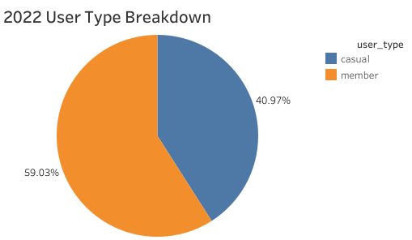
USER TYPE BREAKDOWN
annual members
accounted for 59.03% of
Total trips, while
casual users
accounted for 40.97%.
This suggest there is a strong base
of loyal customers who may have subscribed to
long-term memberships and most importantly a
base of non-members who have recurring
usage patterns.

Slide 7
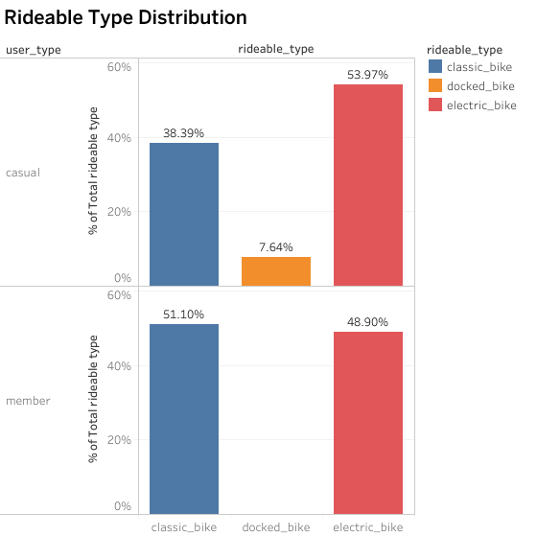
PREFERRED RIDEABLE TYPE
Members prefer classic bikes,
while casual riders opt for electric
bikes, indicating different preferences
for traditional vs. motorized cycling
experiences.

Slide 8
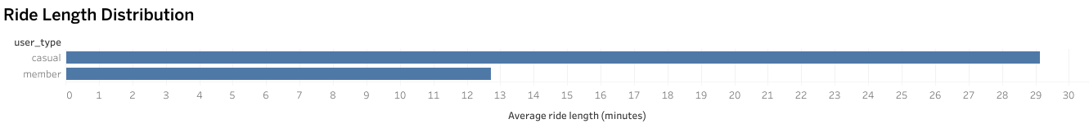
TRIP DURATION
Members have slightly longer average trip durations, potentially indicating a more relaxed riding style or additional stops
during their trips.
Casual riders have slightly shorter average trip durations, suggesting a more direct or faster riding approach.

Slide 9
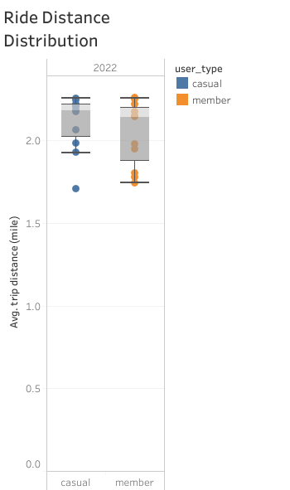
TRIP DISTANCE
Members tend to have shorter trip distances,
suggesting a preference for shorter
commutes or leisurely rides.
Casual riders have longer trip
distances, indicating a preference
for more extensive or adventurous rides.

Slide 10
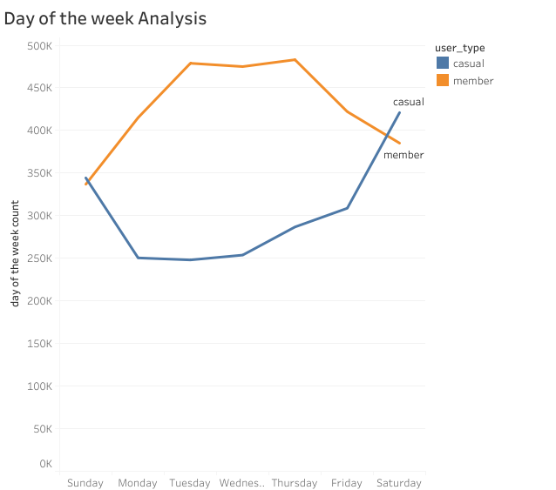
MOST USED DAYS
Members have higher usage on
Saturdays, suggesting a preference
for weekend bike rides.
Casual riders use bike sharing
services more on Thursdays,
indicating a preference for
rides.

Slide 11
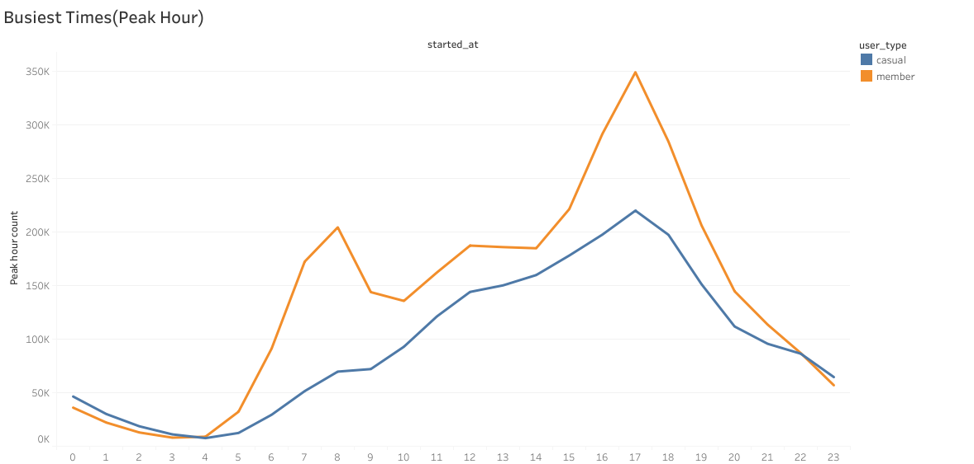
PEAK HOURS
Both members and casual riders
Have peak usage at
5 PM, indicating a common
trend of bike usage during
the late afternoon
or early evening hours.

Slide 12
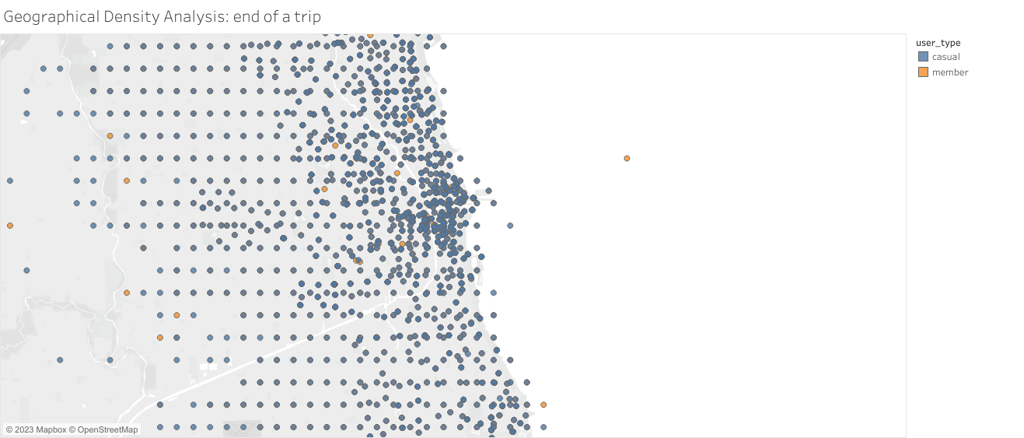
GEOGRAPHICAL DENSITY
Members are concentrated along
the coastal line, indicating a
preference for riding near
the coast or waterfront areas.
Casual riders are more geographically
dispersed, with a presence spanning
throughout the city, indicating a
broader range of riding destinations.

Slide 13
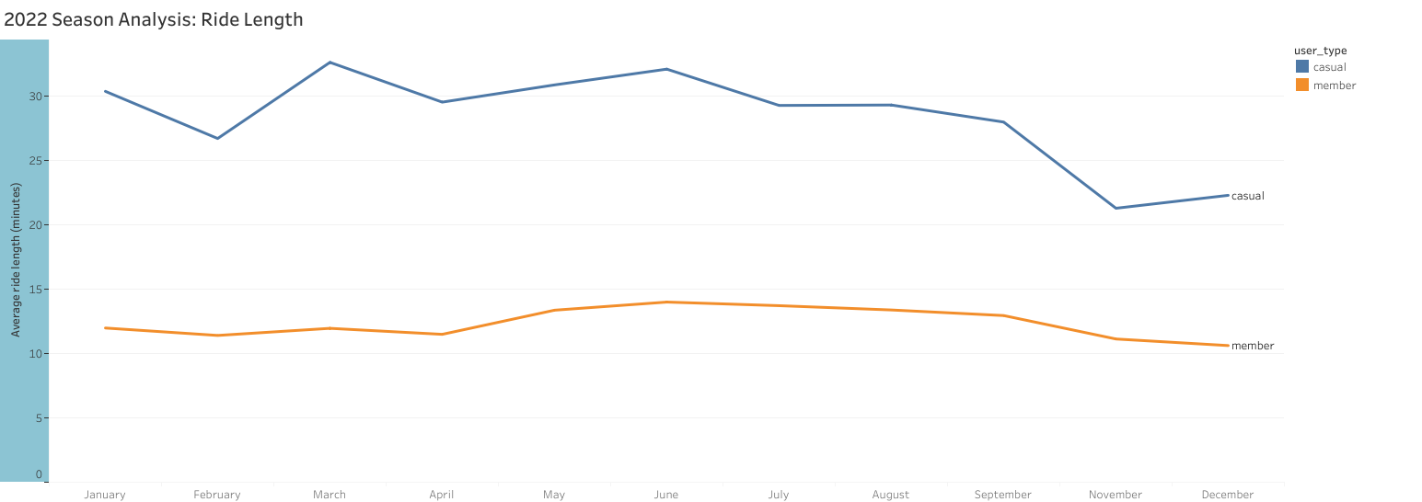
SEASON TREND: RIDE LENGTH
Members' bike usage remains
relatively constant throughout
the year, suggesting
a consistent preference for bike
sharing regardless of the season.
Casual riders show a seasonal
trend, with higher usage in warm
and hot seasons
and lower usage during cold weather,
likely influenced by weather conditions
and outdoor
activities.

Slide 14
ANALYSIS SUMMARY: Casual riders
Casual riders' preferences and patterns in their bike-sharing behavior:
They primarily opt for electric bikes, commonly used for commutes.
Their usage peaks on Thursdays, suggesting a preference for weekday rides.
They tend to embark on longer trips, indicating a desire for more extensive or adventurous rides.
They also have approximately 2 times longer trip durations, influenced by various factors, including traffic conditions, bike-sharing station availability, user behavior, and the purpose of the trip.
Geographically, casual riders are dispersed throughout the city, indicating a broader range of riding destinations.
Their bike usage shows a seasonal trend, with higher activity in warm and hot seasons and lower usage during colder weather, likely influenced by weather conditions and outdoor activities.

Slide 15
ANALYSIS SUMMARY: Members
Members, on the other hand, exhibit different preferences and behaviors compared to casual riders:
They prefer classic bikes over electric ones, indicating a preference for a more traditional cycling experience.
Their usage peaks on Saturdays, indicating a preference for weekend bike rides.
Members tend to have shorter trip distances, suggesting a preference for shorter commutes or leisurely rides.
They also have slightly longer average trip durations, potentially indicating a more relaxed riding style or additional stops during their trips.
Geographically, members are concentrated along the coastal line, indicating a preference for riding near the coast or waterfront areas. Unlike casual riders, their bike usage remains relatively consistent throughout the year, reflecting a consistent preference for bike sharing regardless of the season.

Slide 16
RECOMMENDATION
Offer Incentives for Conversion
Offer incentives for conversion such as a discount or free trial on the first month of subscription.
Membership Package
Tailor membership packages that satisfy casual riders' usage preferences and patterns.
This could include the benefits of:
Priority access to bikes during peak hours or priority access to bikes in the most popular stations.
Access special discounts at their selected stations during spring and summer.
Partner with local stores to offer access to exclusives or discounts. It may be local stores that sell bike merchandise and items of clothing.

Slide 17
RECOMMENDATION
3. Integrate the mobile app
The app may include features such as:
Dedicated customer support
Personalized recommendations for popular biking paths, areas with higher or lower bike usage
Showcasing the widely available docking stations and availability of bikes in various locations
Receives notification of the discounts and other benefits of the seasons
The app will not only enhance the user experience but also proactively engage with casual riders to understand their needs, preferences, and concerns

Slide 18
APPENDIX
Data source: The data has been made available by Motivate International Inc. under this license.
Full analysis process: github.com/SandisiweB/ A case study-Cyclistic bike-share analysis casest

Slide 19
THE END.
THANK YOU !
Sandisiwe Buthelezi
sandigugb@gmail.com
github/SandisiweB

